Slide 1


PANIMALAR ENGINEERING COLLEGE
DEPARTMENT OF ARTIFICIAL INTELLIGENCE AND DATA SCIENCE
FINAL PROJECT VIVA VOICE
FINAL YEAR PROJECT
AI-POWERED UNAUTHORIZED PARKING DETECTION SYSTEM FOR RESIDENTIAL AREAS
BATCH NO: 10
TEAM MEMBERS:
DHANISH CHANDER. P (211421243034)
GIFTSON. P. C (211421243051)
GAUTHAM. M. S (211421243048)
PROJECT SUPERVISOR:
MR. VIVEK. C, M.E.,
Associate Professor
Department t of AI&DS

Slide 2
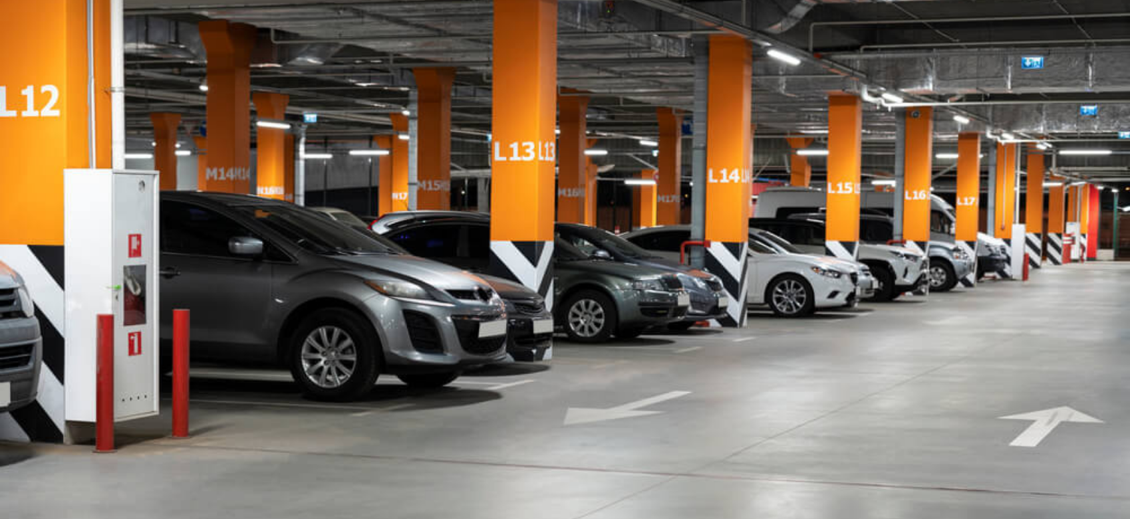
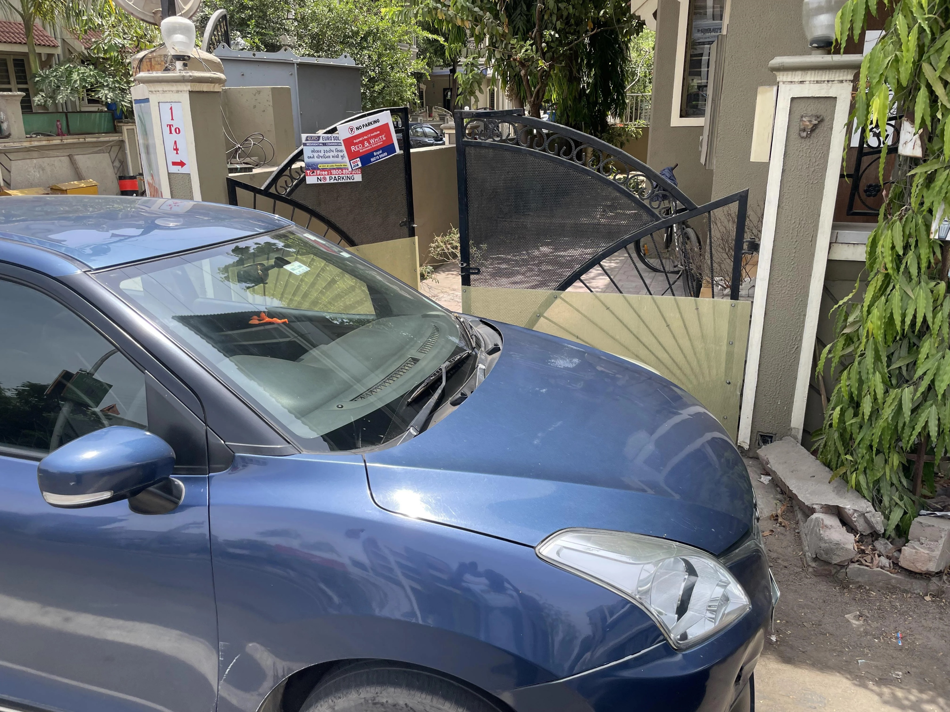
PROBLEM STATEMENT
1. Unauthorized Use of Parking Spaces by Guests: Guests in residential complexes often use designated parking areas meant for apartment holders without being aware of the parking rules, leading to parking space misuse.
2. Parking in No Parking Zones: Vehicles are frequently parked in front of houses where parking is prohibited, causing inconvenience and potential safety concerns.

Slide 3

Introduction:
Unauthorized parking in private parking areas leads to congestion and collisions.
Our research addresses these challenges with the Ai-powered Unauthorized Parking Detection System .
By leveraging advanced technologies, we aim to enhance security, optimize space utilization, and improve the overall parking experience.

Slide 4
Objectives:
Mitigating unauthorized parking and collisions.
Aim for a smoother parking experience for legitimate users.
01
02
03
Implementing real-time monitoring and proactive alert mechanisms.

Slide 5
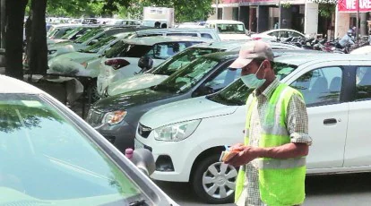
Existing Methodology:
Current parking area surveillance methods often rely on manual intervention, leading to inefficiencies and dependency on human availability.
Traditional systems lack the capability to monitor and alert unauthorized parking instances effectively.

Slide 6
Proposed Solution:
The Ai-powered Unauthorized Parking Detection System integrates hardware components such as NodeMCU, Arduino microcontrollers, RFID technology, and advanced deep learning algorithms like YOLO version 8.
This system enables automated vehicle detection, user identification, and real-time monitoring of parking areas.
By leveraging these technologies, we aim to provide a comprehensive solution to the persistent challenges associated with parking management.

Slide 7
Literature Review:
PAPER TITLE | AUTHORS | YEAR OF PUBLICATION | METHOD USED
Real-Time Unauthorized Parking Violation Detection System Using AI Models in Private Parking Lots | Rashid R, Ali F | 2024 | A computer vision-based approach is presented to monitor parking availability by recognizing and tracking vehicle.
A Smart Real-time Parking Control And Monitoring System | Abdelrahman Osman Elfaki, Wassim Messoudi, Anas Bushnag, Shakour Abuzneid, Tareq Alhmiedat | 2023 | Introduces AI-driven smart parking system to tackle issues like wasted parking, CO2 emissions, and vehicle theft. Dynamically allocates parking slots based on real-time conditions for improved efficiency.
Video-Based Parking Occupancy Detection for Smart Control System. | Lun-Chi Chen, Ruey-Kai Sheu, Wen-Yi Peng, Jyh-Horng Wu, Chien-Hoa Tseng | 2020 | Introduces a computer vision-based parking lot management system with feature-based background modeling and adaptive threshold updating, demonstrating effectiveness through experiments.
Development of a Smart Parking Surveillance System Based on Deep Learning and IOT Technologies. | Xu X, Yu Y | 2023 | Proposes a design strategy for a smart car parking system prototype CCTV and computer vision recognition algorithms, demonstrating effectiveness through simulation evaluation.

Slide 8

Components:
Each component plays a crucial role in the system's functionality:
Camera: For real-time vehicle detection.
Laptop: Runs the YOLO model and processes image data.
NodeMCU: Handles RFID scanning and serial communication with Arduino.
RFID Reader & Tags: For vehicle authentication.
Arduino: Controls the speaker for alerts.
Speaker: Provides audio notifications for unauthorized parking.

Slide 9
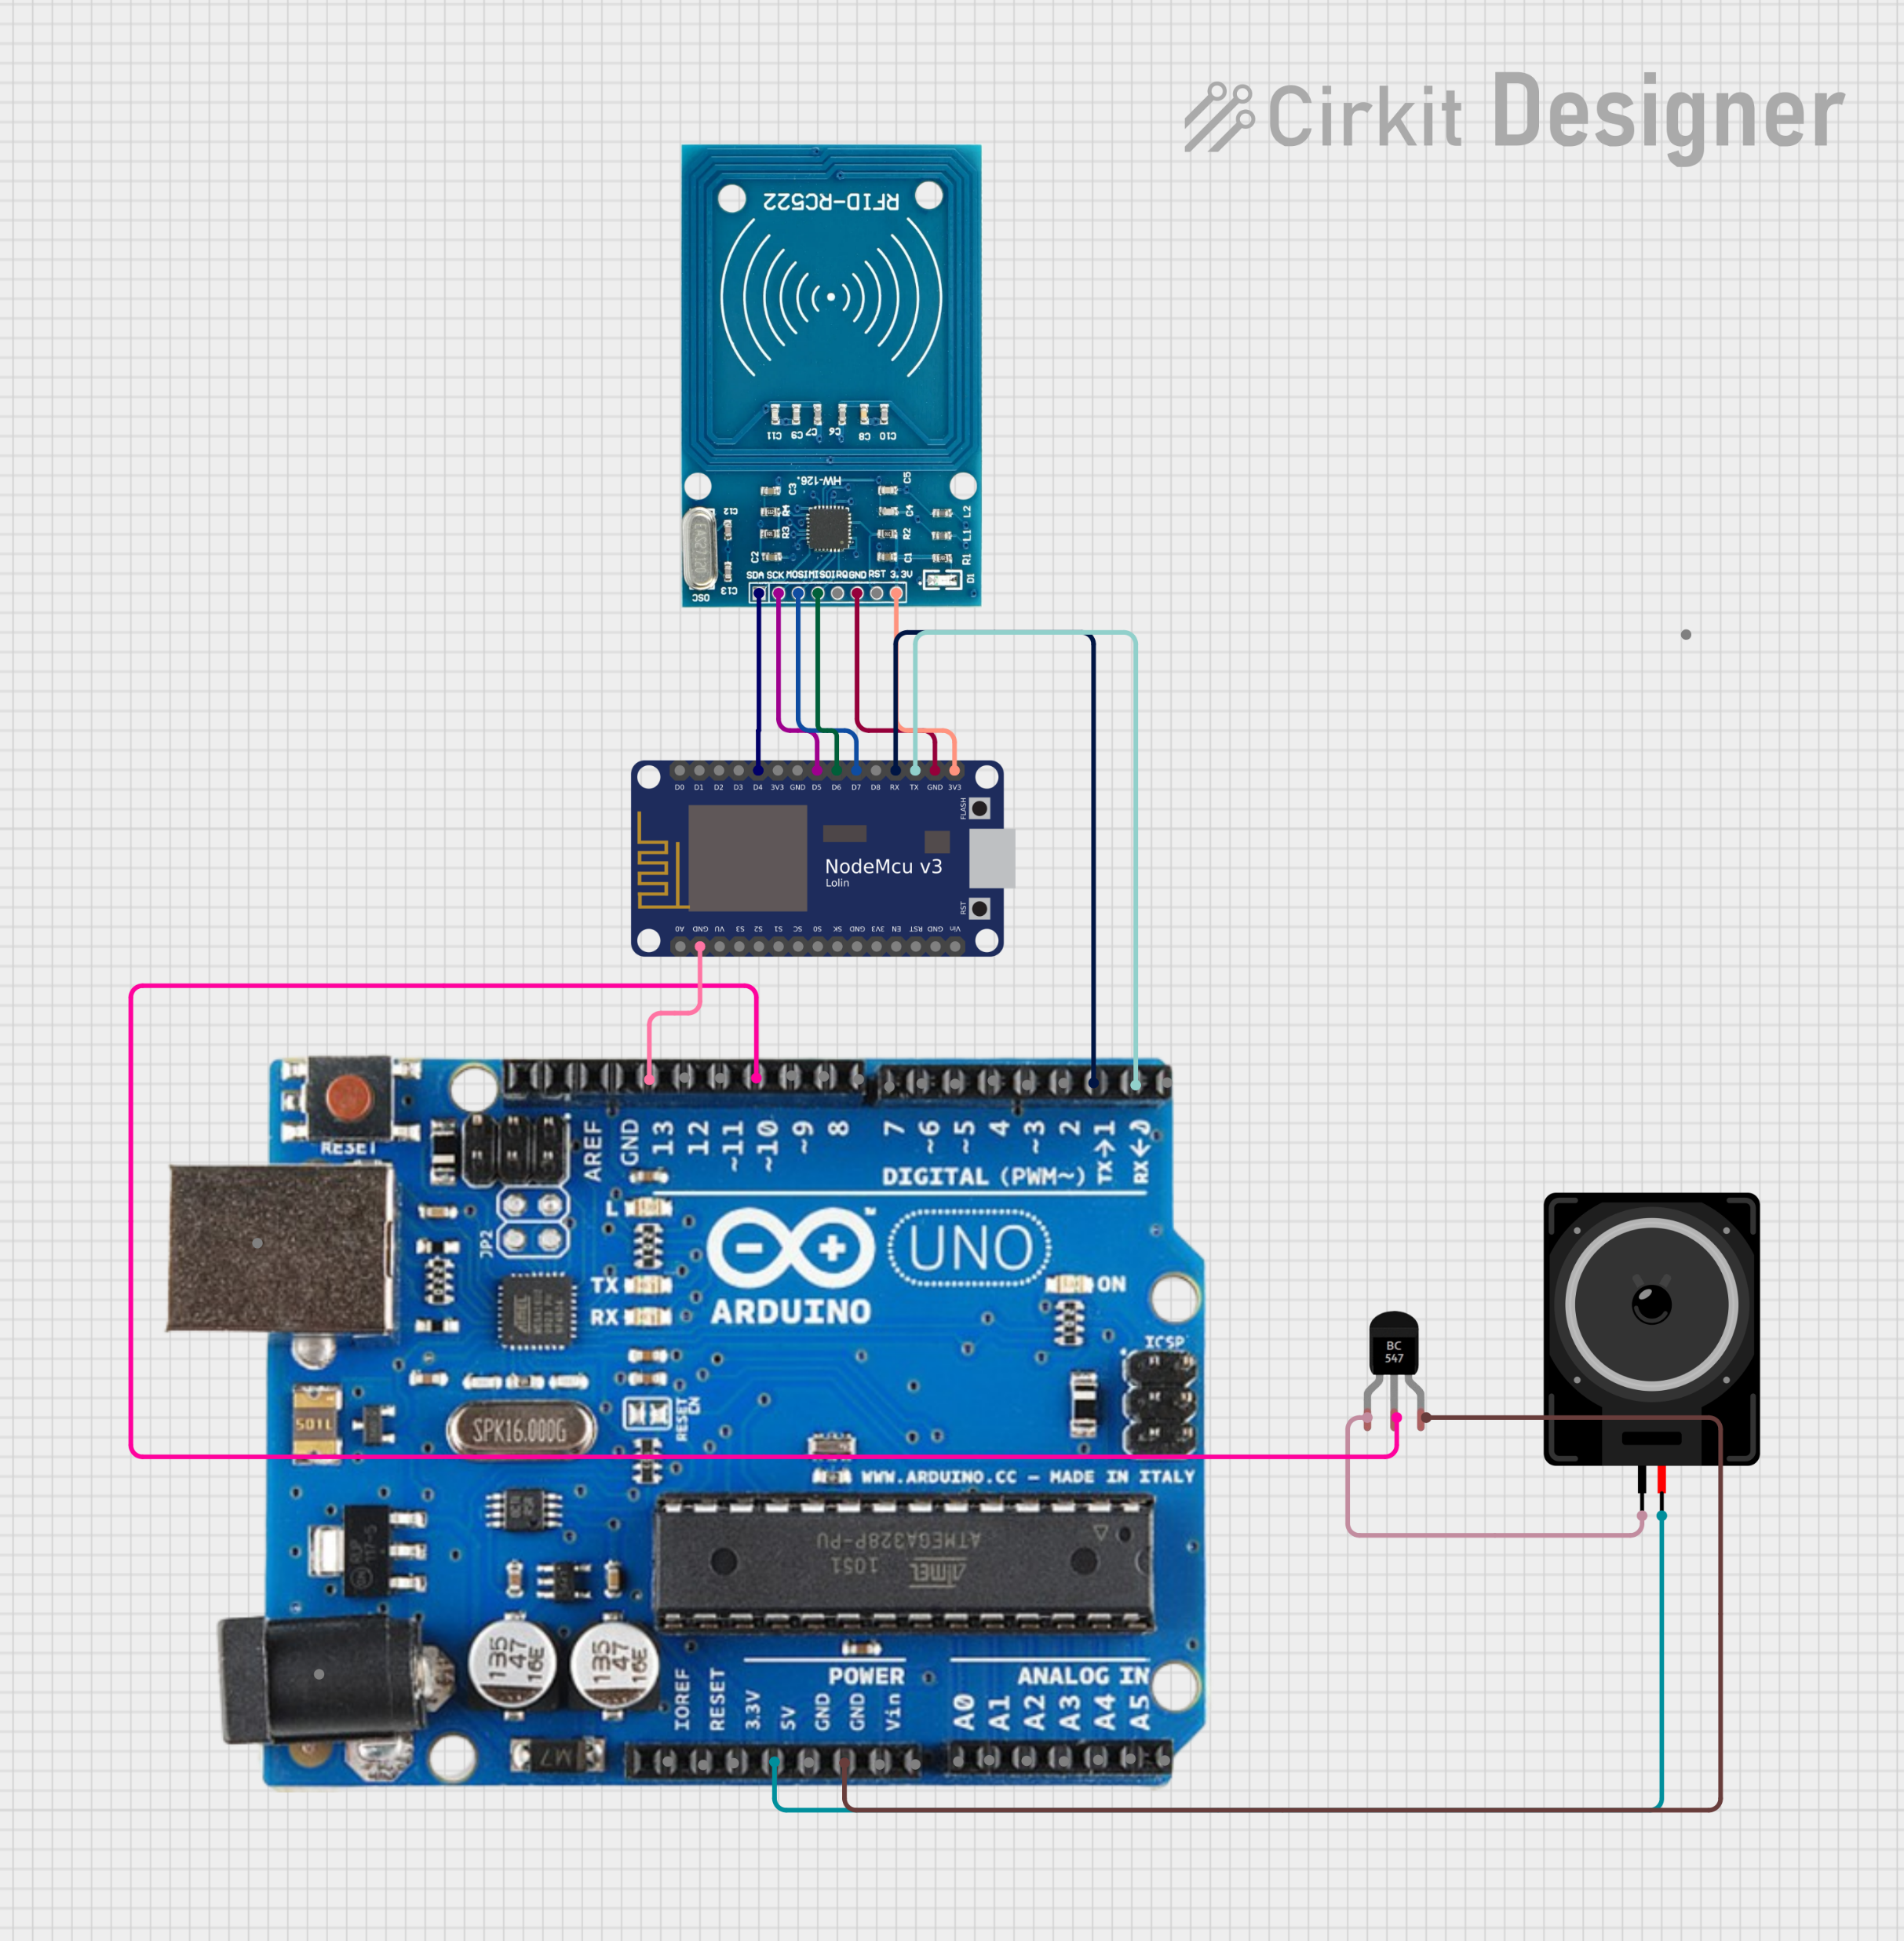
System Architecture:
The system architecture comprises:
Handles RFID scanning and serial communication with Arduino.
RFID reader for user authentication.
YOLO algorithm for real-time object detection and classification.
Arduino controls the speaker for alerts.
Speaker provides audio notifications for unauthorized parking.

Slide 10
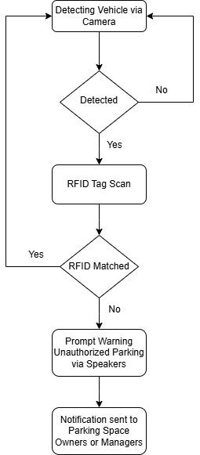
Flow Diagram:

Slide 11
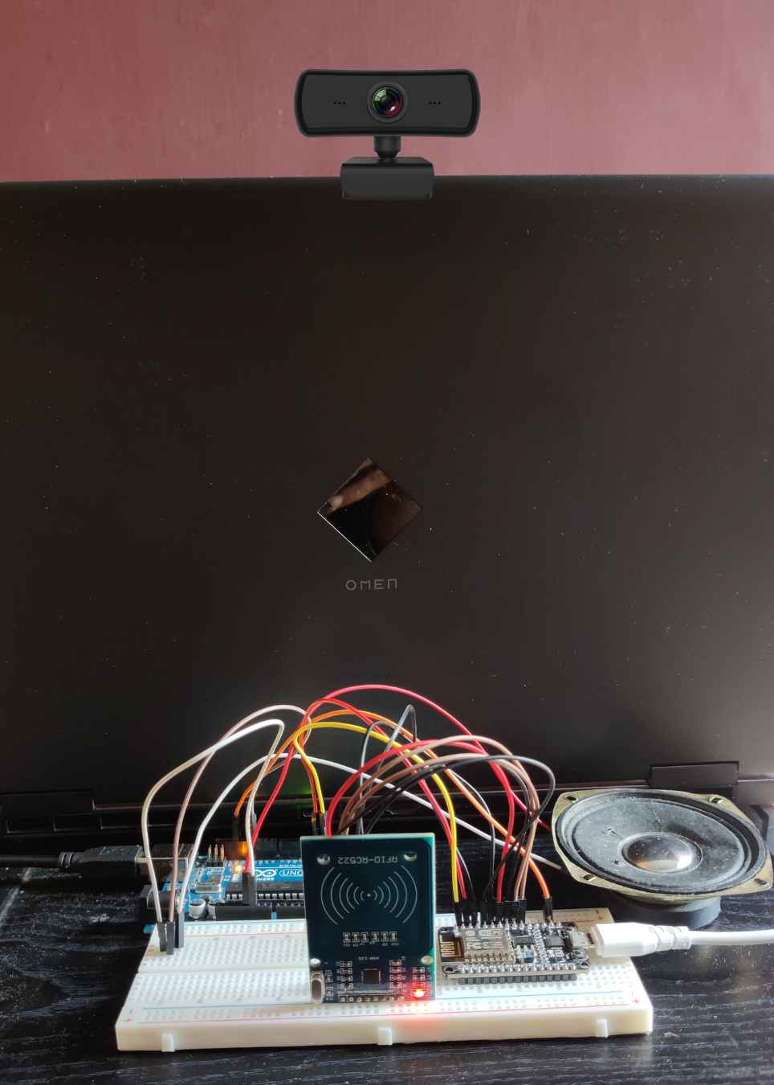
Prototype of the System:
The prototype includes components such as NodeMCU, Arduino microcontrollers, RFID technology, a speaker, laptop and a webcam.
Through real-time demonstrations, we showcase how the system detects vehicles, verifies user authorization, and issues alerts when unauthorized parking is detected.

Slide 12
Problems and Challenges:
High dependence on RFID technology requiring consistent reliability and range management.
Frequent maintenance required for system upkeep and adjustments.
Future Works:
Sending immediate alerts to authorized users upon unauthorized vehicle parking detection.
A dedicated application which captures and sends the vehicle and stores the data for the machine learning analysis.

Slide 13

Conclusion:
The Ai-powered Unauthorized Parking Detection System offers a comprehensive solution to the challenges of unauthorized parking and collisions.
Through the integration of advanced technologies, we aim to provide a safer and more efficient parking environment to the legitimate users of the parking area, ensuring a seamless and secure experience.

Slide 14
Any Questions?

Slide 15
Thank You!

